Slide 1
Stillbirth and Under Five(5) Mortality Rate Along the Years

Slide 2
Introduction
Who are we?
What are we trying to solve with this research?
Why are we doing this?
Notes:
Good morning/afternoon/evening/day. We are team Jasper (which stands for Journey in Analyzing Stillbirth and Population-Based Epidemiological Research), composed of {group members} and we are here to present our research about Stillbirth and Under 5 Mortality Rate along the Years. In this research, we are trying to identify the regions, both the UNICEF and SDG regions, who are successful in combating the stillbirth and under 5 mortality rate from the year 2010 up until 2021. As stated by the USAid, A high stillbirth rate may reflect inadequacies in antenatal and intrapartum care and can be an indication of the quality and coverage of essential, referral and emergency care for women during pregnancy and childbirth. While Exemplars in Global Health states that high under-five mortality is usually the result of a combination of failures including poor nutrition, low immunization rates, poor maternal health and education, etc.

Slide 3

Definition of Key Terms
Stillbirth - the death or loss of a baby before or during delivery. Both miscarriage and stillbirth describe pregnancy loss, but they differ according to when the loss occurs.
Under 5 Mortality - mortality or death of children under the age of five years old.
Notes:
Before proceeding with the objectives of this research, let me first establish our key terminologies used in this research

Slide 4
Table of contents
Objectives
01
02
Methodology
Results analysis
03
04
Conclusions
What this research aims to achieve
What method was used to gather information
What were the results of the analysis
What the researchers recommend

Slide 5
01
Objectives
- What the researchers aims to do

Slide 6
“This research aims to identify the regions that has the lowest stillbirth and under five mortality rate. By identifying the regions that has been successful in combating these dilemmas, we’ll try to replicate their practices that has led to achieving such numbers. The sets of data that was utilized in this study was dated from 2010 to 2021.”
Notes:
This research aims to:
Identify the regions that have the lowest rate of stillbirth and mortality rate along the years
Identify their practices in that lowered their stillbirth and mortality rates

Slide 7

Notes:
This research is also in line with SDG number 3 which promotes good health and well-being. This research is specifically under SDG 3.2.1 which is about under 5 mortality rate.

Slide 8
02
Methodology
- How the researchers are going to treat the data

Slide 9
Methodology
The researchers will conduct this research by analyzing the datasets from UNICEF data science explorers. The researchers utilized datasets relating to the mortality rate of children under five years of age as well as the stillbirth rate of every region, both for the Sustainable Development Region as well as UNICEF Region. Analysis as to which region proves to have the lowest rate of stillbirth and mortality rate will be chosen as the basis as to how one region should combat stillbirth and mortality rate. After careful analysis, recommendations will be made as to what practices should every region, more specifically, every woman in different regions should put into action.

Slide 10
03
Result Analysis
- What the researchers found after the data analysis

Slide 11
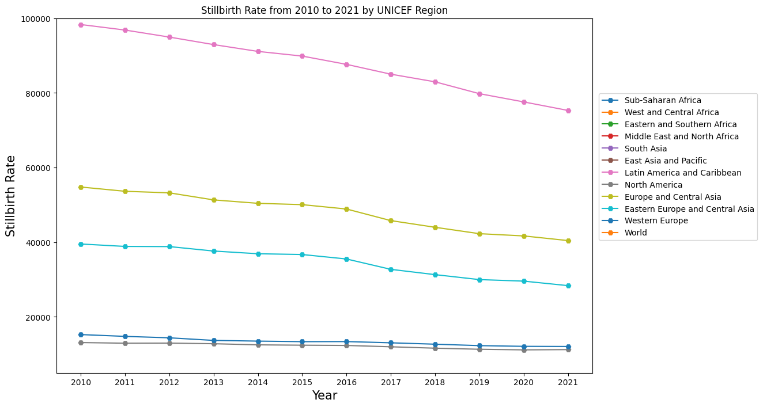

Slide 12
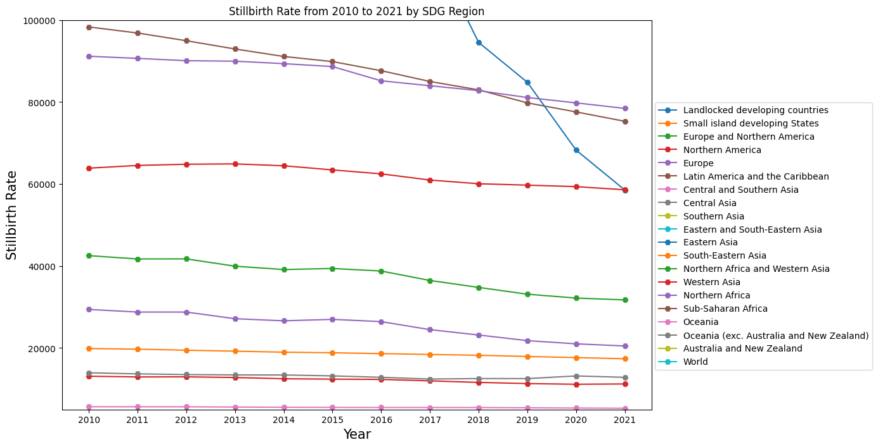

Slide 13
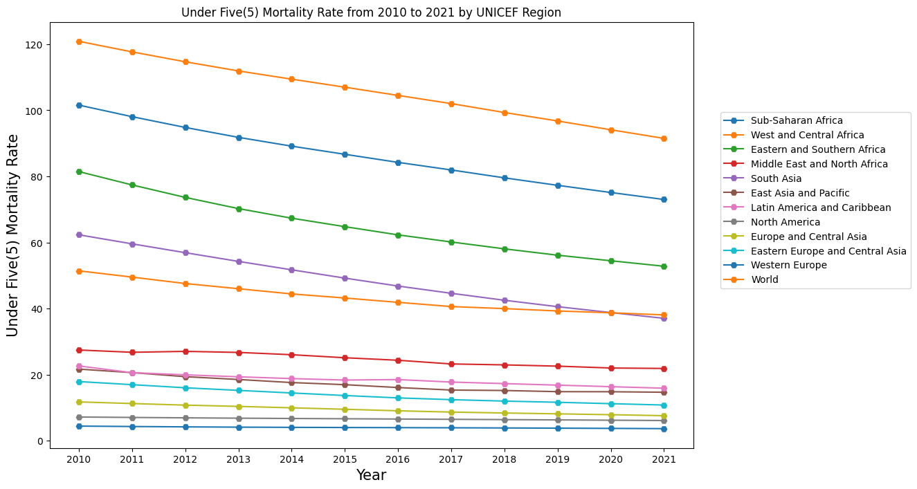

Slide 14
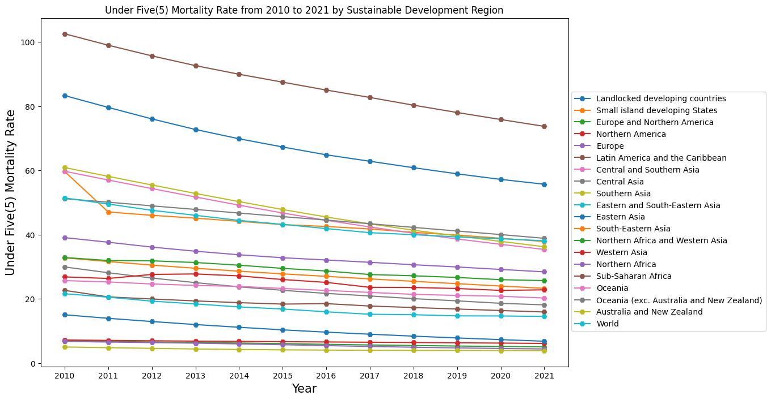

Slide 15
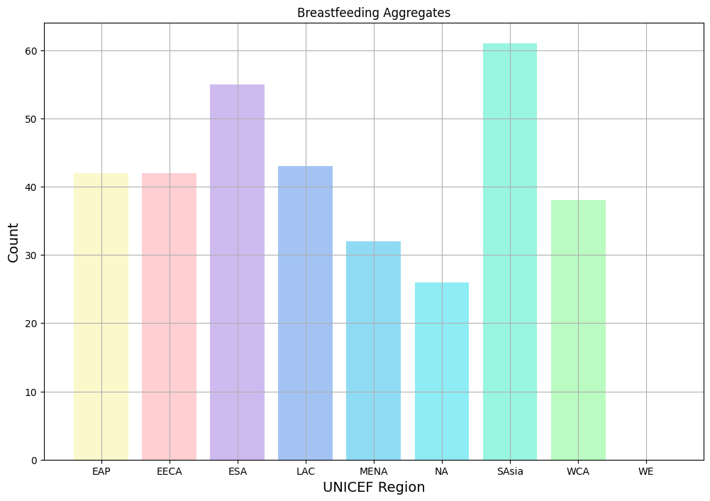

Slide 16
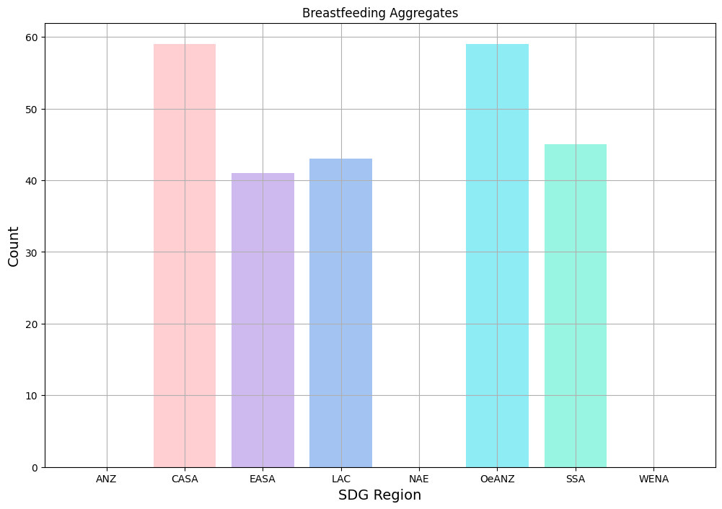

Slide 17
04
Conclusion
- What the researchers concluded after data analysis

Slide 18
38/1000 live births
In 2021, this has been the ratio of under five mortality rate

Slide 19
13.9/1000 live births
In 2021, this has been the ratio of stillbirth rate

Slide 20
Conclusions
North America has recorded the lowest rate of stillbirth from 2010 to 2021 per Unicef Region
Oceania has the least record of stillbirth rate when it comes to Sustainable Development Region from 2010 to 2021
South Asia and Eastern and Southern Africa who have a high breastfeeding aggregates has low Under 5 mortality rate via UNICEF Region
Oceania and Central and Southern Asia who has the highest breastfeeding aggregates resulted to have low Under 5 mortality rate via SDG Region

Slide 21
Thanks!
The researchers:
Rondero, Vincent Patrick S.
Aclan, Jod Matthew P.
Salazar Jasper
Please keep this slide as attribution

Slide 22
Research resources
https://ourworldindata.org/child-mortality-in-the-past - decreasing mortality rate
https://onlinelibrary.wiley.com/doi/full/10.1111/j.1365-3016.2012.01281.x?fbclid=IwAR2t6LD3Lk-7t7I4V5d1ImfBTi3gONMWvIzZIYadmpqlgImMntbeAOW5qdo -
https://malariajournal.biomedcentral.com/articles/10.1186/1475-2875-11-400#:~:text=Burden%20of%20malaria%20in%20infants%20aged%20less%20than%20six%20months&text=Various%20studies%20across%20Africa%20have,those%20found%20in%20the%20mother. -newborn affected by malaria
https://www.msdmanuals.com/home/children-s-health-issues/infections-in-newborns/overview-of-infections-in-newborns - Overview of Infections in Newborns
https://www.who.int/data/gho/data/themes/topics/sdg-target-3_2-newborn-and-child-mortality?fbclid=IwAR0A3zhwWxo-pys1sinMMcbnaltEq8gNjeuSRxHC7YkgwgMoaiFJEWc3biY - end preventable
https://stacks.cdc.gov/view/cdc/7062 - pregnancy-related mortality
https://data.unicef.org/topic/child-survival/stillbirths/
https://data.unicef.org/topic/child-survival/under-five-mortality/

